Slide 1
“IPNB – a precursor to cholangiocarcinoma”
Michael A Silva
Consultant HPB Surgeon
Department of HPB Surgery
University Hospital Oxford NHS FT

Slide 2
A patients story
43F; epigastric discomfort
Multiple visits to GP
Months in to complaint; US Scan of abdomen

Slide 3
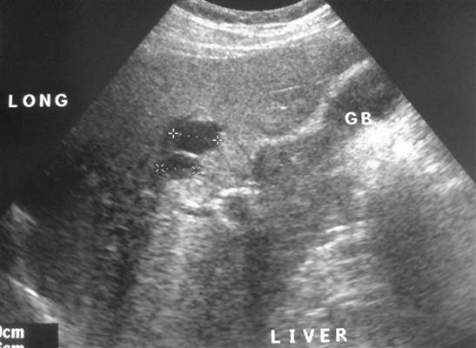
US Scan of abdomen

Slide 4
CT scans + MRI of Liver (Multihance)

Slide 5
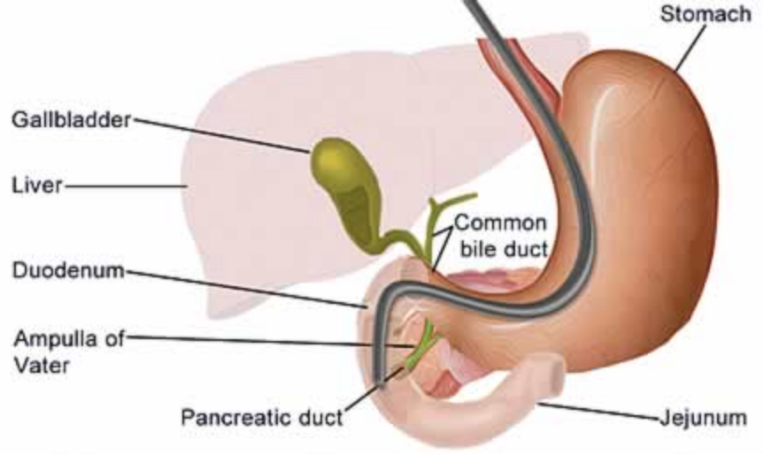
ERCP : Endoscopic Retrograde Cholangiopancreatography

Slide 6
ERCP: Occlusion cholangiogram
Cystic Intraductal Papillary Neoplasm of Bile duct (IPNB)

Slide 7
A patients story
43F; epigastric discomfort
Possible IPNB
Could be pre cancerous
Would need 3/4 of liver removed; extended left hepatectomy
Patient deferred recommended surgery
16 months later re-presented with jaundice; Extended left hepatectomy
Moderately differentiated adenocarcinoma, locally invasive (negative margins and nodes)
Died 14 months later with wide spread peritoneal disease

Slide 8
Cholangiocarcinoma
Late presentation
Many arise de novo
Two pre-malignant lesions
biliary intra-epithelial neoplasia – only seen microscopically
intraductal papillary neoplasm of the bile duct – visible macroscopically
- can be seen on scans

Slide 9
IPNB is a recent diagnostic entity
World Health Organization (WHO) reclassification of tumours★
IPNB encompasses a number of previous entities
Biliary papillomatosis
Intraductal neoplasia of the liver
Mucin-producing intraductal cholangiocarcinoma
Intraductal papillary mucinous tumour of the bile duct
★WHO classification of tumours of digestive system.
Lyon, France: IARC Press; 2010. p. 222e4.236-238.

Slide 10
IPNB natural history
Stepwise progression adenoma to adenocarcinoma cf to colonic polyps
Dysplasia progressing to carcinoma.
40-50% of IPNB have foci of invasive carcinoma.
Even with transformation to CCa, IPNB has a better 5-year survival
Median 52 months compared with 28 months
Histopathological similarity to intraductal papillary mucinous neoplasm
of the pancreas (IPMN-P)

Slide 11
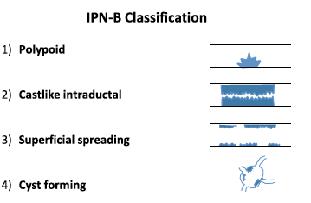
Four morphological subtypes of IPN-B

Slide 12
Histologically, four morphological IPNB subtypes exist
Intestinal
Pancreaticobiliary
Gastric
Oncocytic
cf IPMN-P

Slide 13
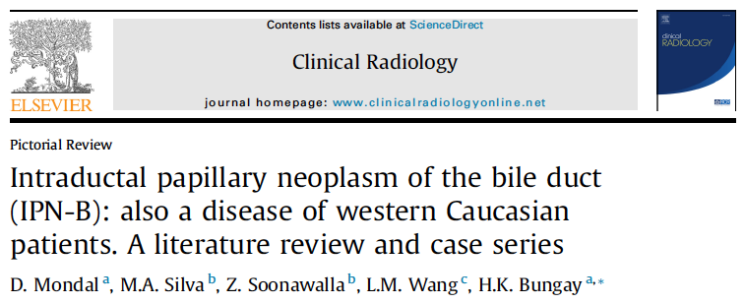

Slide 15
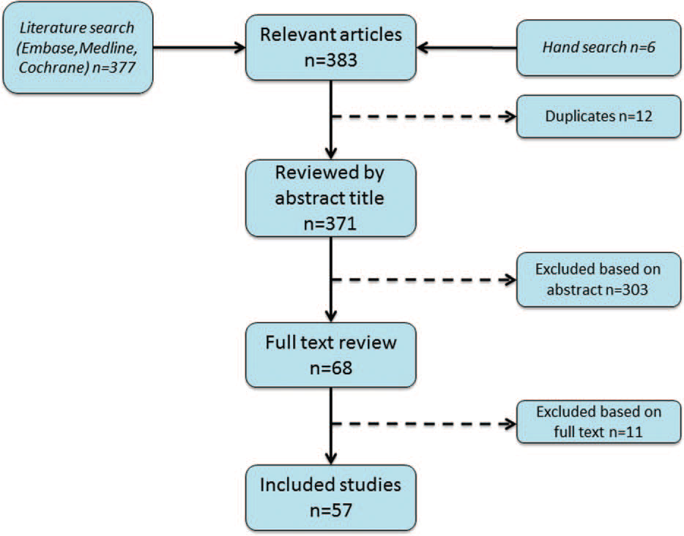

Slide 16
IPNB Conclusions
Invasive component was identified in 43% of 476 IPNBs
Pancreaticobiliary-type significantly higher incidence of invasive disease
Higher expression glycosylated type 1 transmembrane protein MUC1
Papillary type CCA in those with invasive disease (better outcomes)
Adverse outcome in IPNB with lymph nodal metastasis
C. Sinensis (liver fluke) is likely to play an etiological role

Slide 17
Four morphological subtypes of IPNB

Slide 18
Polypoid IPNB
71 M; incidental abnormal LFT’s
Extended liver resection + Roux loop reconstruction
3.5 cm moderately differentiated adenocarcinoma
Well 50 months post operation

Slide 19
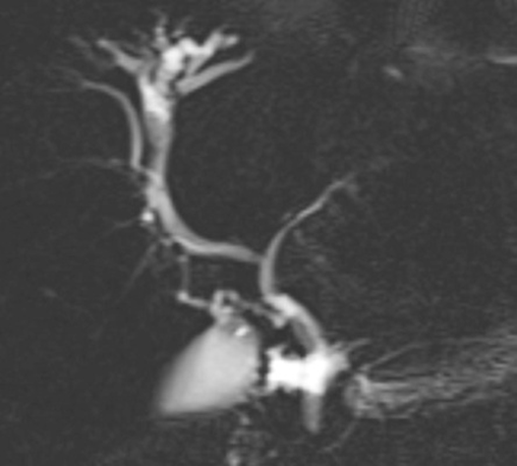
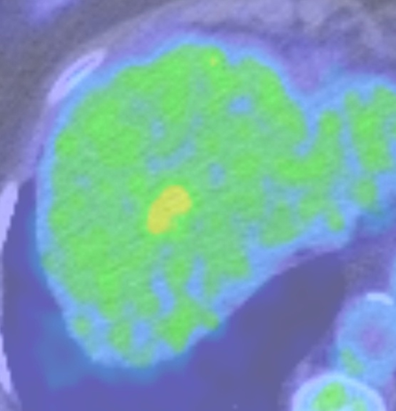
Castlike IPNB
76 F; FU following colorectal cancer treatment
Extended liver resection
Low grade dysplasia

Slide 20
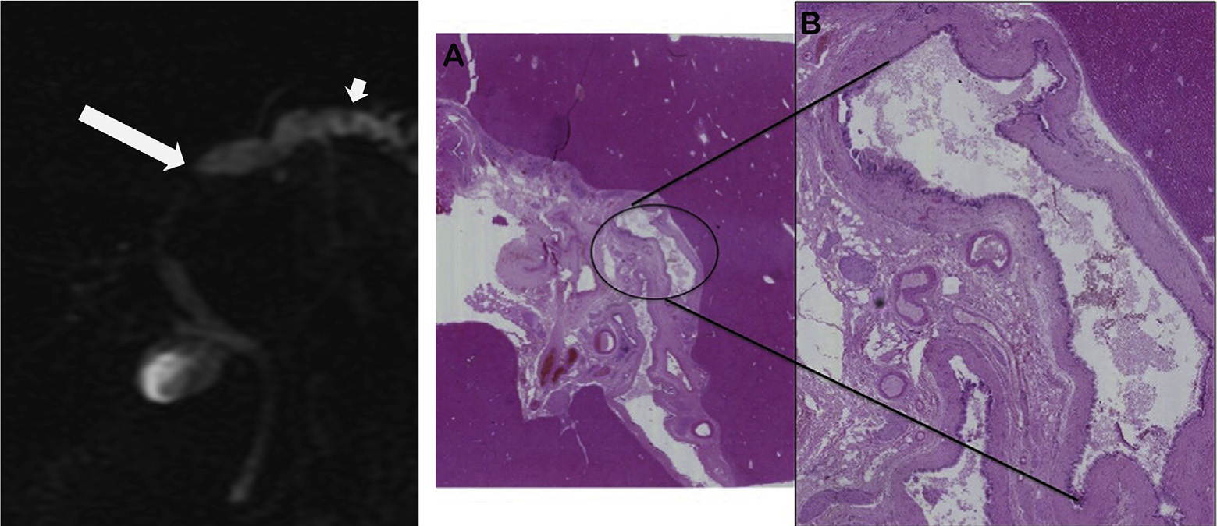
Superficial IPNB
48 F; night sweats and LFT’s
Low grade dysplasia post left hemi-hepatectomy

Slide 21
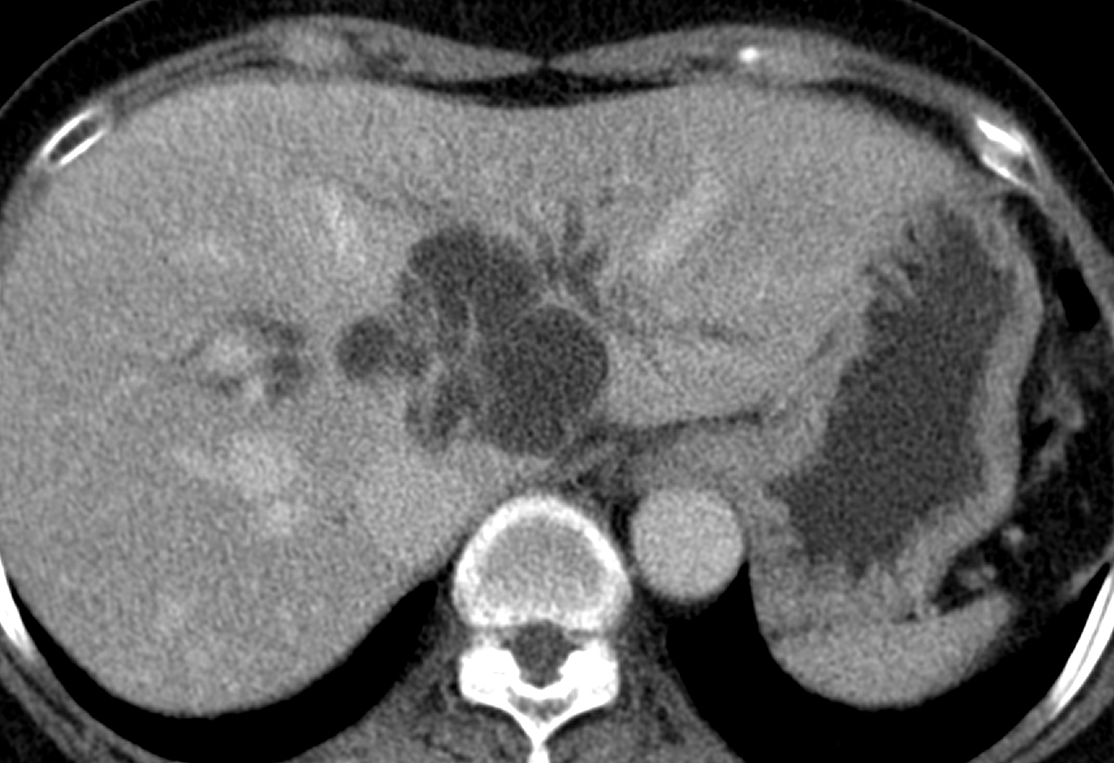
Cyst forming IPNB
46 F; incidental finding on scans
Extended left hepatectomy
High grade dysplasia

Slide 22
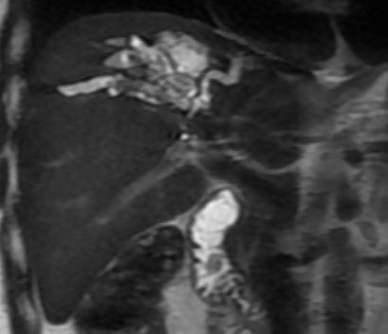
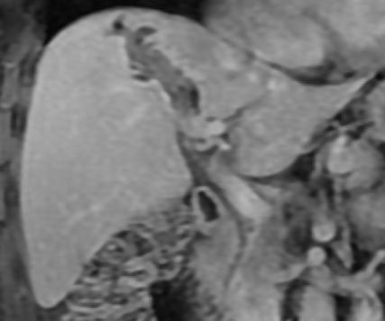
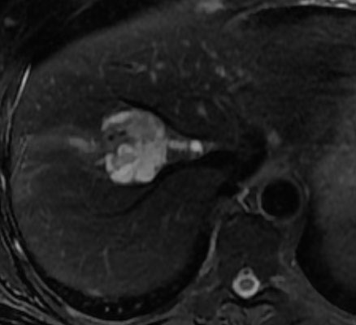
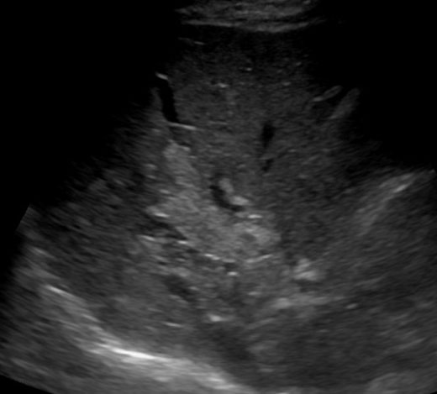
Cystic/cast-like IPNB with CCA

Slide 23
Important considerations with imaging
Longstanding biliary dilatation is not always innocent – can develop over years
Tumour can be anywhere in the dilated segment, not only the apex
Fluctuating, unexplained biliary dilatation and jaundice is suspicious
Extent of cystic lesion is not necessarily extent of CCa
Opportunity for radiologists to detect pre-malignant lesion or early cancer
Often asymptomatic or minimally symptomatic – incidental finding
Radiologist might be only person considering the diagnosis

Slide 25
Differential diagnosis
Any cause of biliary dilatation, including post-operative stricture
Calculi
Inspissated bile
Typical CCA
Biliary metastases
Granulomata
Cystadenoma
Caroli’s
Cystic metastases

Slide 27
Justification for a national database for IPNB patients
Understand natural history of all types of IPNB
Increase awareness among radiologists thus hopefully increase early diagnosis of CCa
Provide guidelines for timing of surgery and frequency of surveillance/follow up
Data on survival after treatment
Ability to prognosticate at diagnosis

Slide 28
Justification for a national database for IPNB patients
Histopathological basis
Are Papillary subtype of CCa (PCC) and IPNB different histological entities
or is noninvasive IPNB a precursor lesion for PCC?
Comparison of the mutation status may help resolve this
Pancreatobiliary subtype; increased MUC1 expression plus invasive status
Does this represent further progression along the adenoma-carcinoma sequence, or whether pancreatobiliary subtypes have different mutation set to other IPNB tumour types
Identify any other significant biomarkers

Slide 29
Acknowledgements
Helen Bungay – Consultant HPB Radiologist Oxford
Jae Hoon Lim – Consultant HPB Radiologist – Seoul, South Korea
Eve Fryer – Consultant HPB Pathologist Oxford
Alex Gordon Weeks – Academic Clinical Lecturer Oxford
Katy Gordon Quayle – Clinical Nurse Specialist and Data Manager

